Slide 1
AWS Availability-Cost Analysis
Vijay Reddiar (Based on Reducing Risk in AWS by Andrew Templeton)

Slide 2
Agenda
Why we need AWS Availability-Cost Analysis?
AWS Availability-Cost Analysis Methodology
Analysis in Detail
Summary of Analysis
Q&A

Slide 3
Why we need AWS Availability-Cost Analysis?
Myth
Going to AWS Cloud makes IT available all time
Fact
AWS provides capabilities to make system highly available
Provided, we architect the system to use the capabilities
Cost sky rockets if business does not understand the under pinning's
Cost Analysis
Provides Financial View Point using Technology Architecture Options

Slide 4
AWS Availability-Cost Analysis Methodology
Parameters Used
AWS standard SLA’s
Availability Risk in terms of Outage Duration
Loss of Revenue/Year due to system unavailability
Goodwill Factor
REST API - System Availability Improvement Architecture
Simple System Architecture
Availability Zone Aware-Auto Scaling Architecture
Regional Active-Passive Replication Architecture
Regional Active-Active Replication Architecture

Slide 5
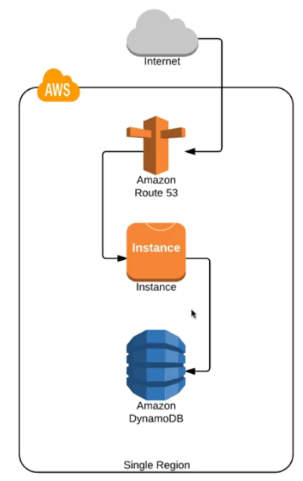
Simple System Architecture

Slide 6
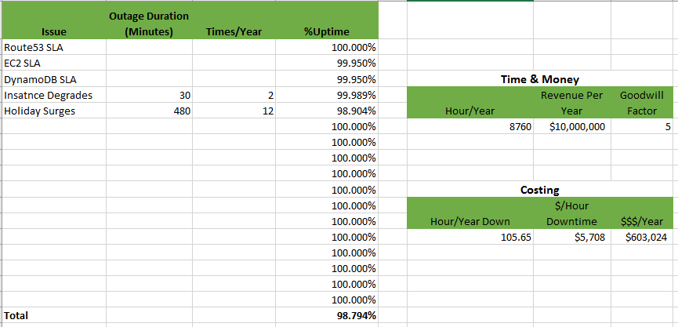
Simple System Architecture-Cost

Slide 7
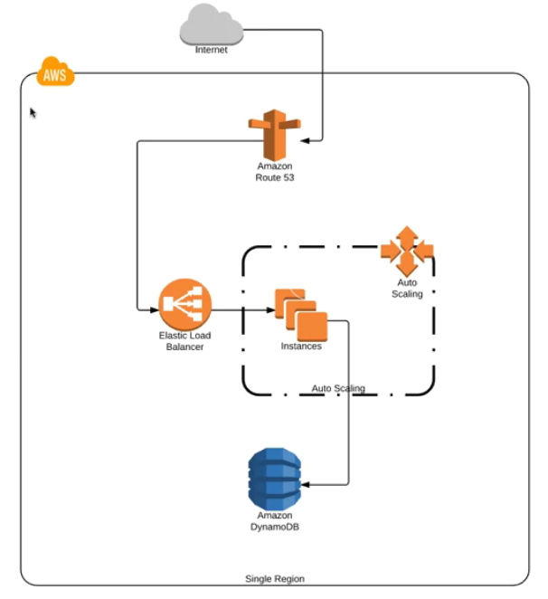
Availability Zone Aware-Auto Scaling Architecture

Slide 8
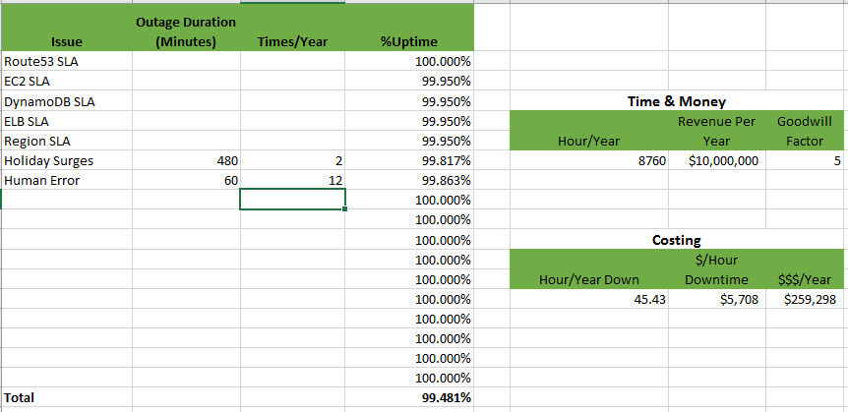
Availability Zone Aware-Auto Scaling Architecture Cost

Slide 9
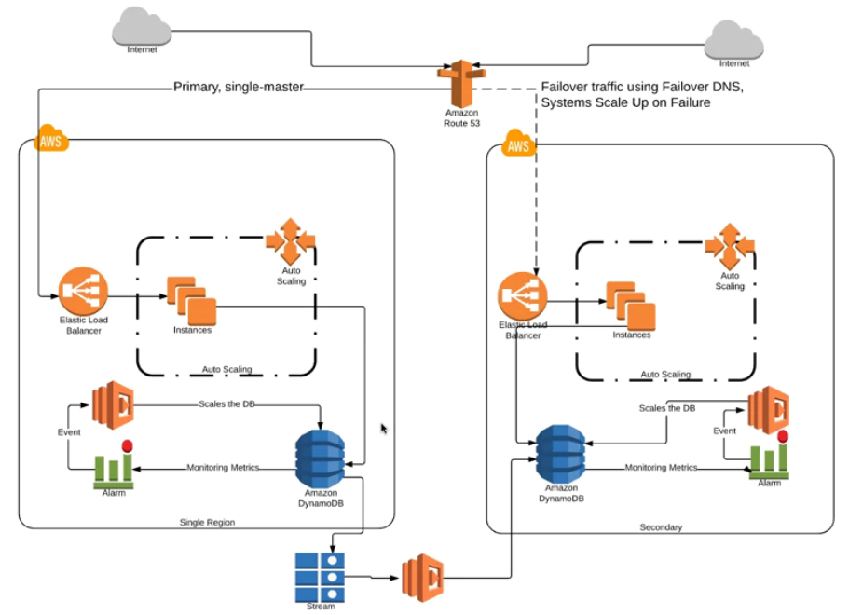
Regional Active-Passive Replication Architecture

Slide 10
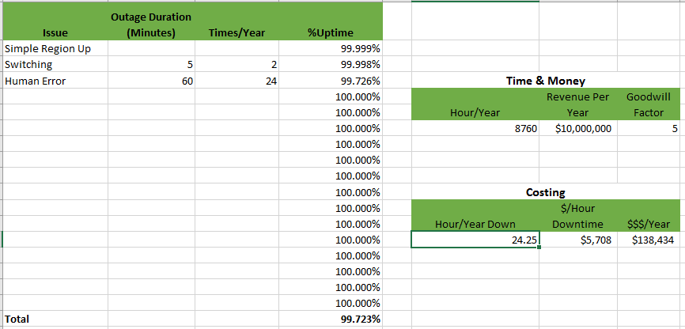
Regional Active-Passive Replication Architecture Cost

Slide 11
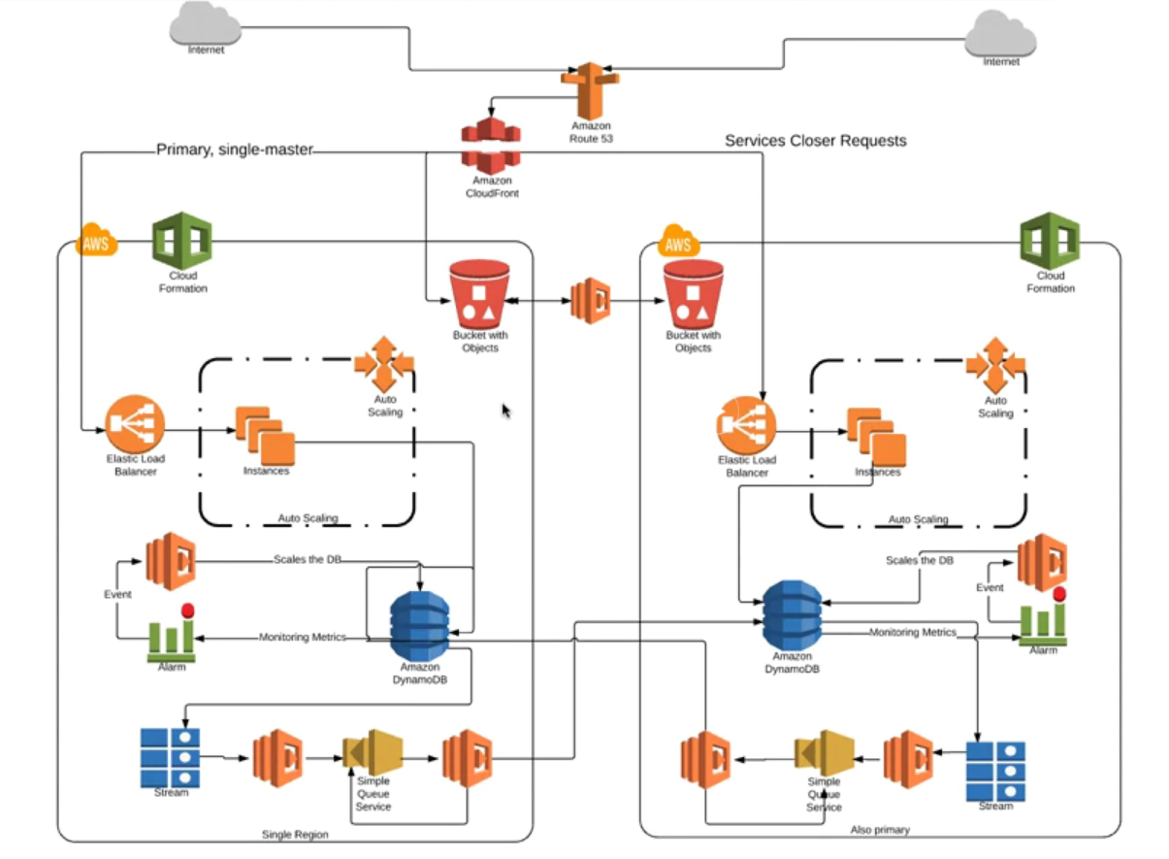
Regional Active-Active Replication Architecture

Slide 12
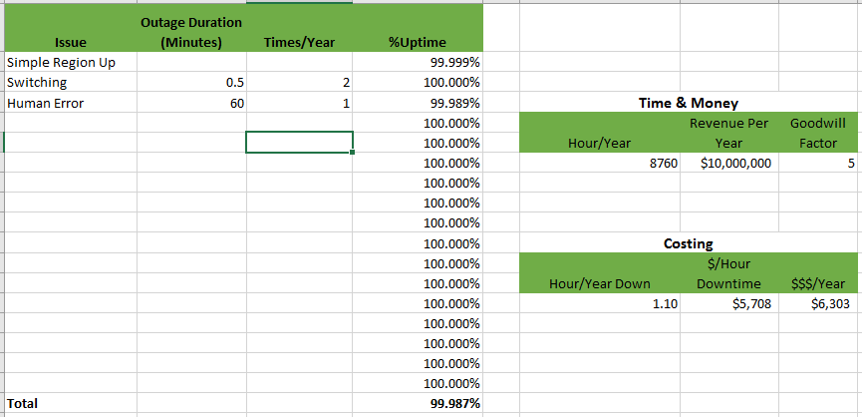
Regional Active-Active Replication Architecture Cost

Slide 13
Summary of Analysis

Slide 14

Q&A

